Slide 1
Object Oriented Programming Lab CSE 1206
Lab 6

Slide 2
Inheritance
Class that is inherited is called SUPERCLASS
Class that does the inheriting is called SUBCLASS
Syntax: using extends keyword
class Subclass-name extends Superclass-name
{
//methods and fields
}

Slide 3
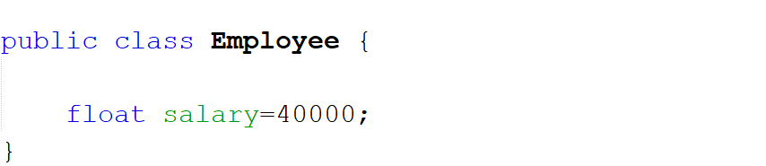
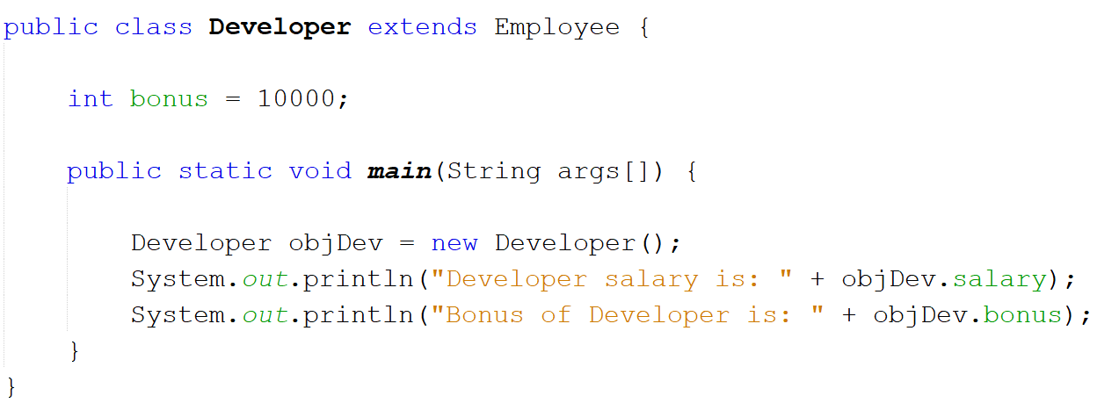
Super Class
Sub Class

Slide 4
Single Level Inheritance

Slide 5
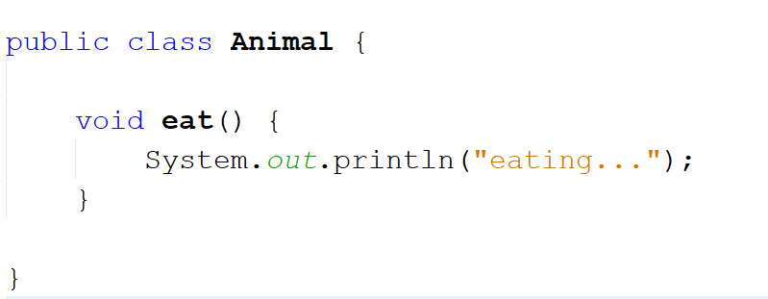
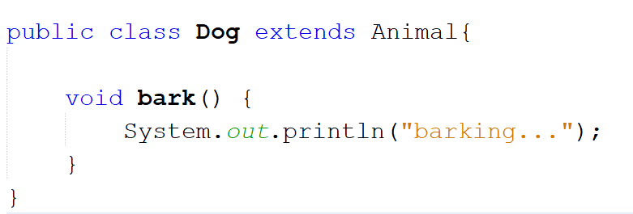
Super Class
Sub Class

Slide 6
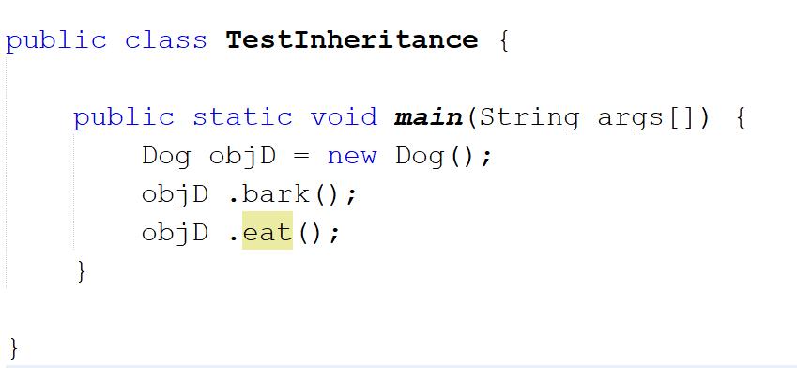
Testing the Inheritance in Main Class

Slide 7
Hierarchical Inheritance

Slide 8
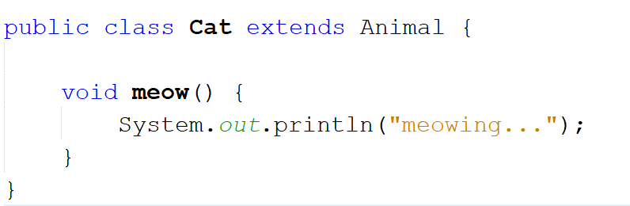
Sub Class 2 of Super Class Animal

Slide 9
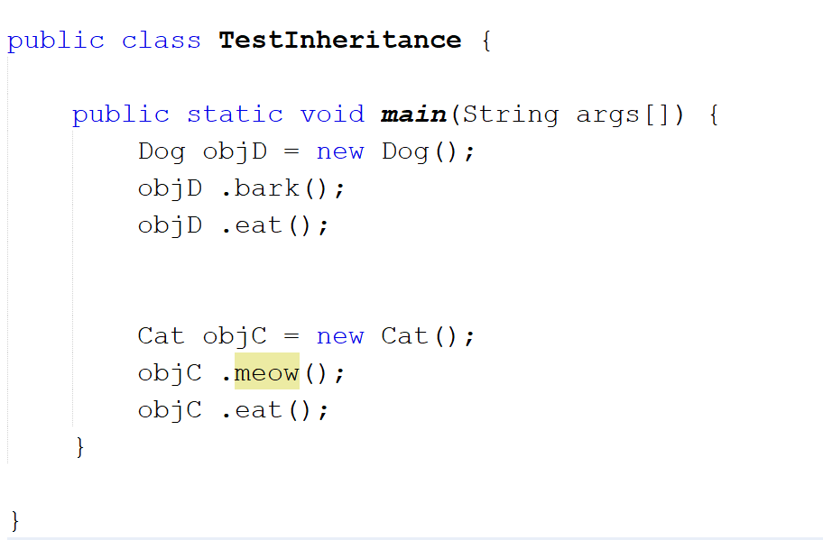

Slide 10
Multilevel Inheritance

Slide 11
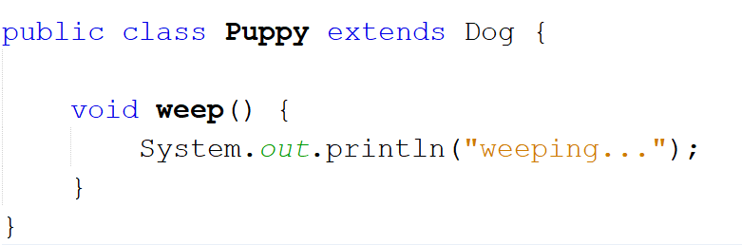

Slide 12
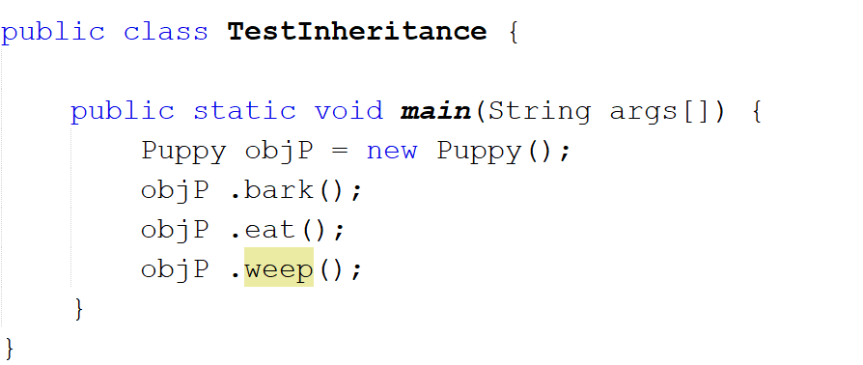

Slide 13
A private member is not accessible by the sub classes.

Slide 14
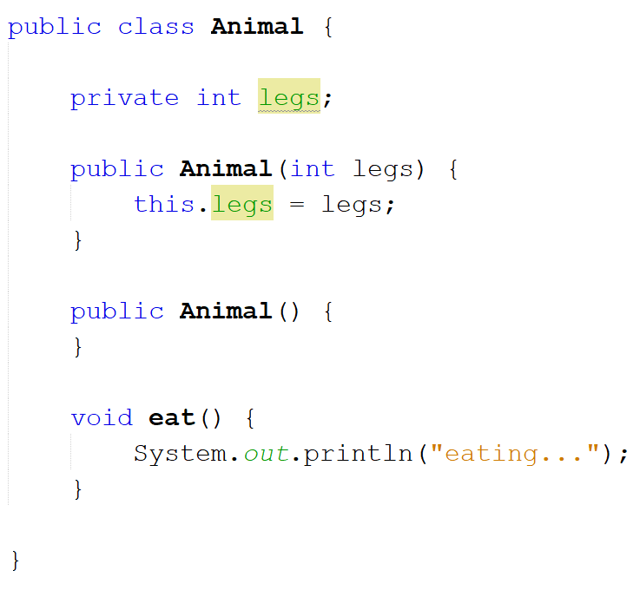

Slide 15
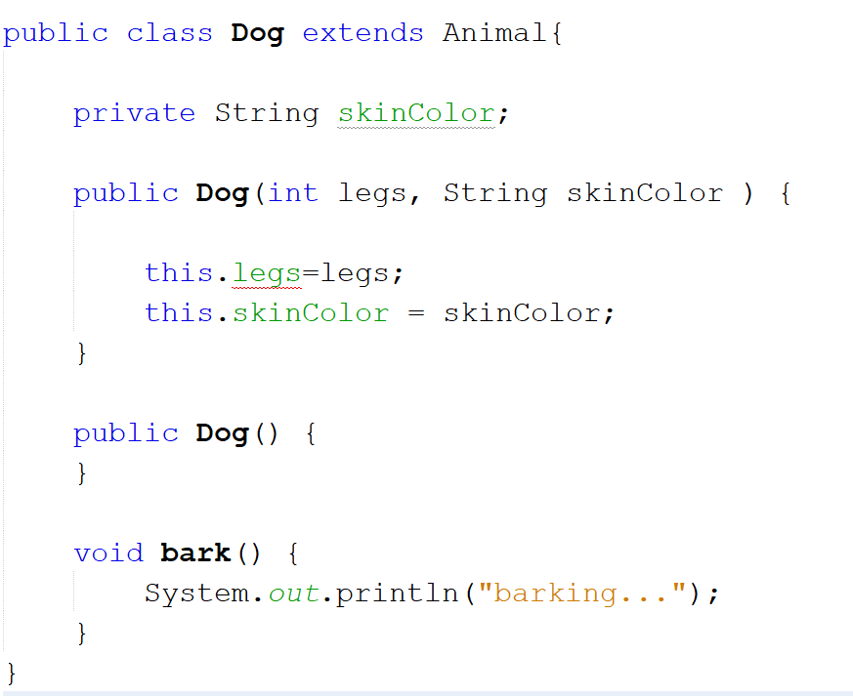
Error:
Legs has private access in Animal

Slide 16
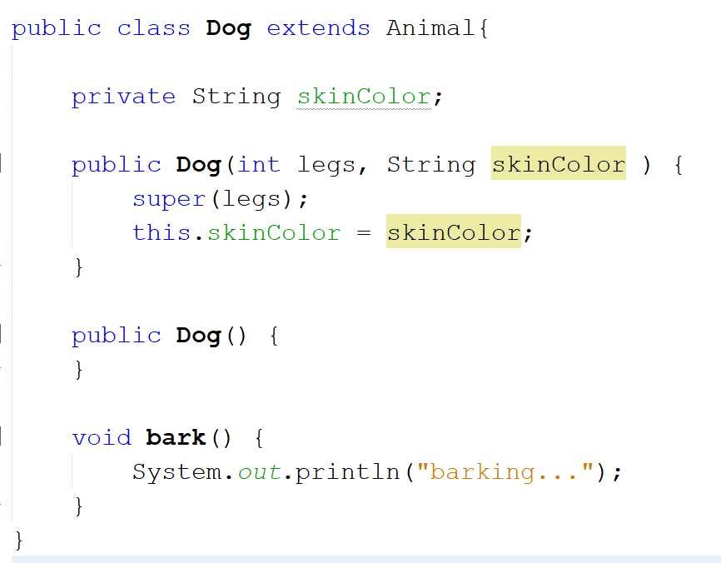
Solution

Slide 17
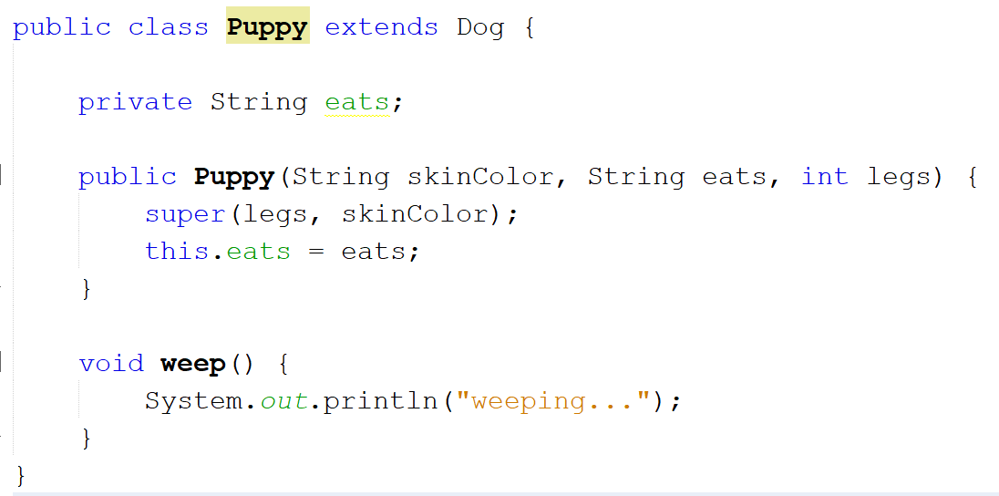

Slide 18
Second use of Super is Similar to the use of this keyword.

Slide 19
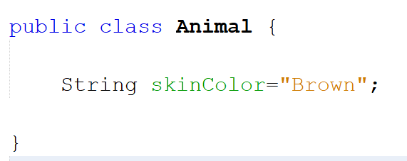
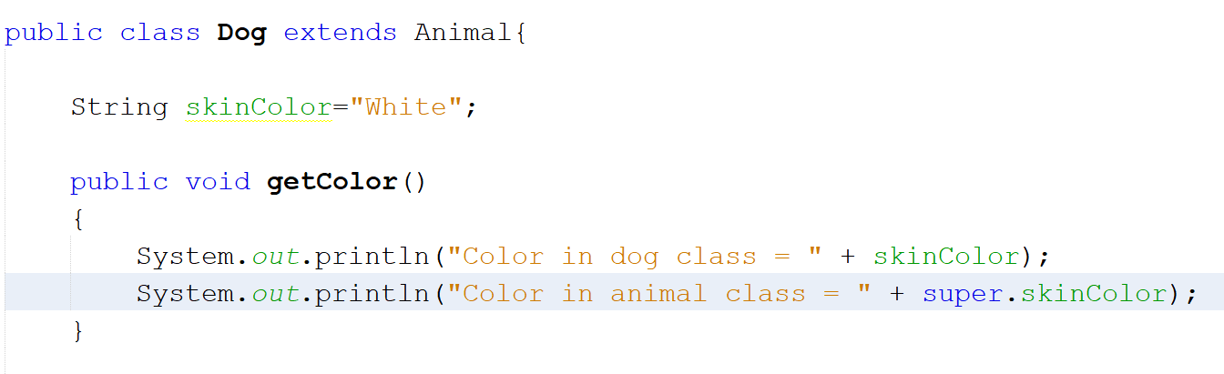

Slide 20
